Slide 1
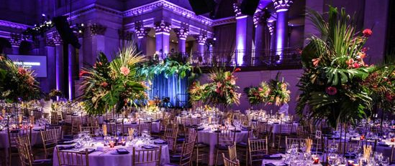
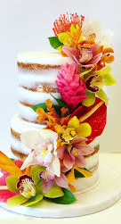

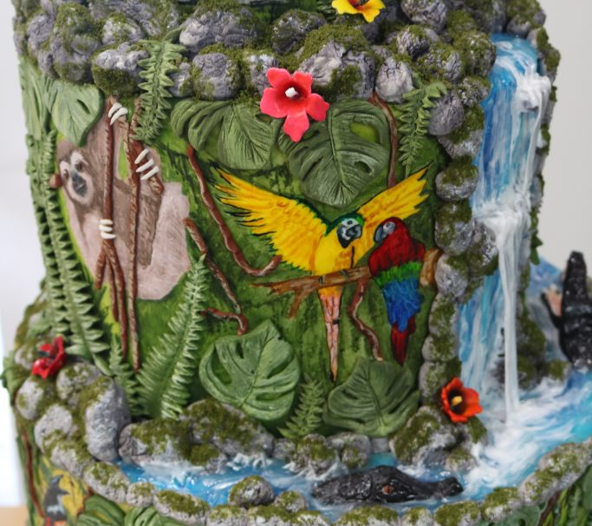
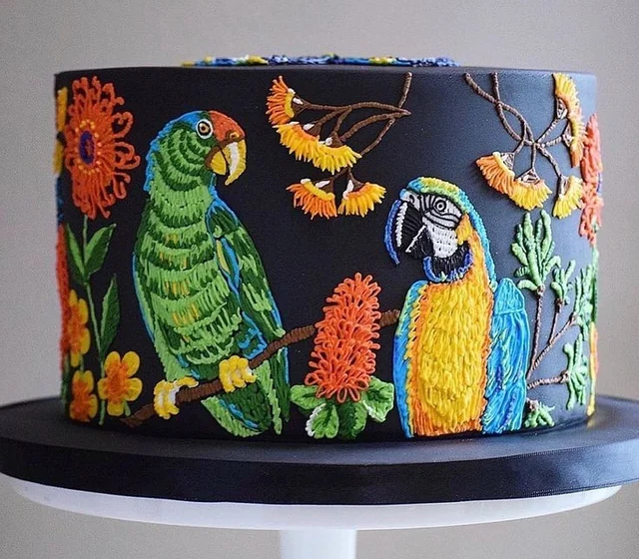

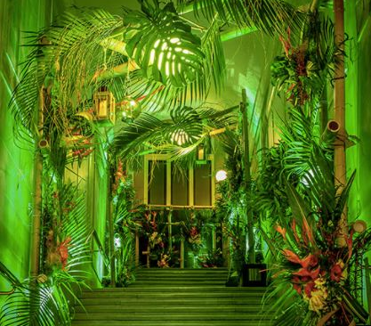
Experience the wonder of the rainforest at the 39th Annual Chocolate Ball.
Prepare to be captivated by nature’s wonder and indulge in show-stopping cakes inspired by the rainforest’s untamed beauty.

